Slide 1
Quantum-enhanced Markov chain Monte Carlo
Yunzhe Zheng
2022/6/12

Slide 2
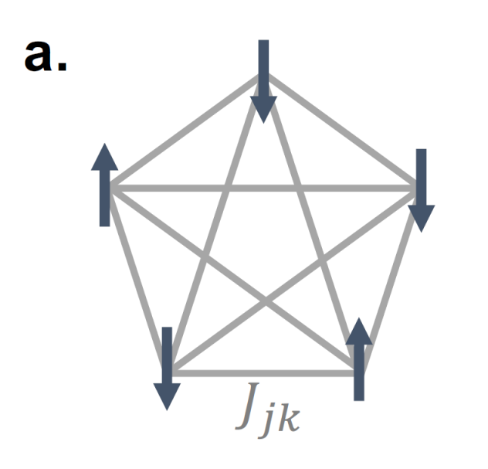
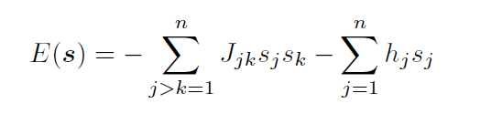
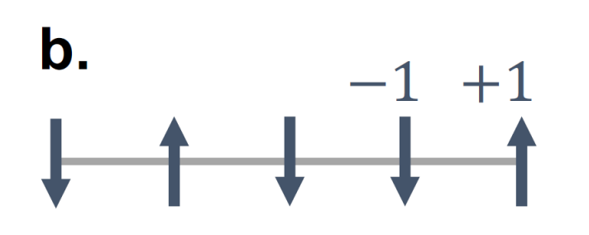


Sampling distribution of Ising models
Given a random Ising model
We want to know its Boltzmann distribution:
This problem is significant in:
Statistic Physics - Sampling system quantities!
Machining Learning – Boltzmann machine
Optimization
$$μ\left(s\right)=\frac{1}{Z}e^{−E\left(s\right)/T}$$
$Z=∑e^{−E\left(s\right)/T}$ Partition function

Slide 3

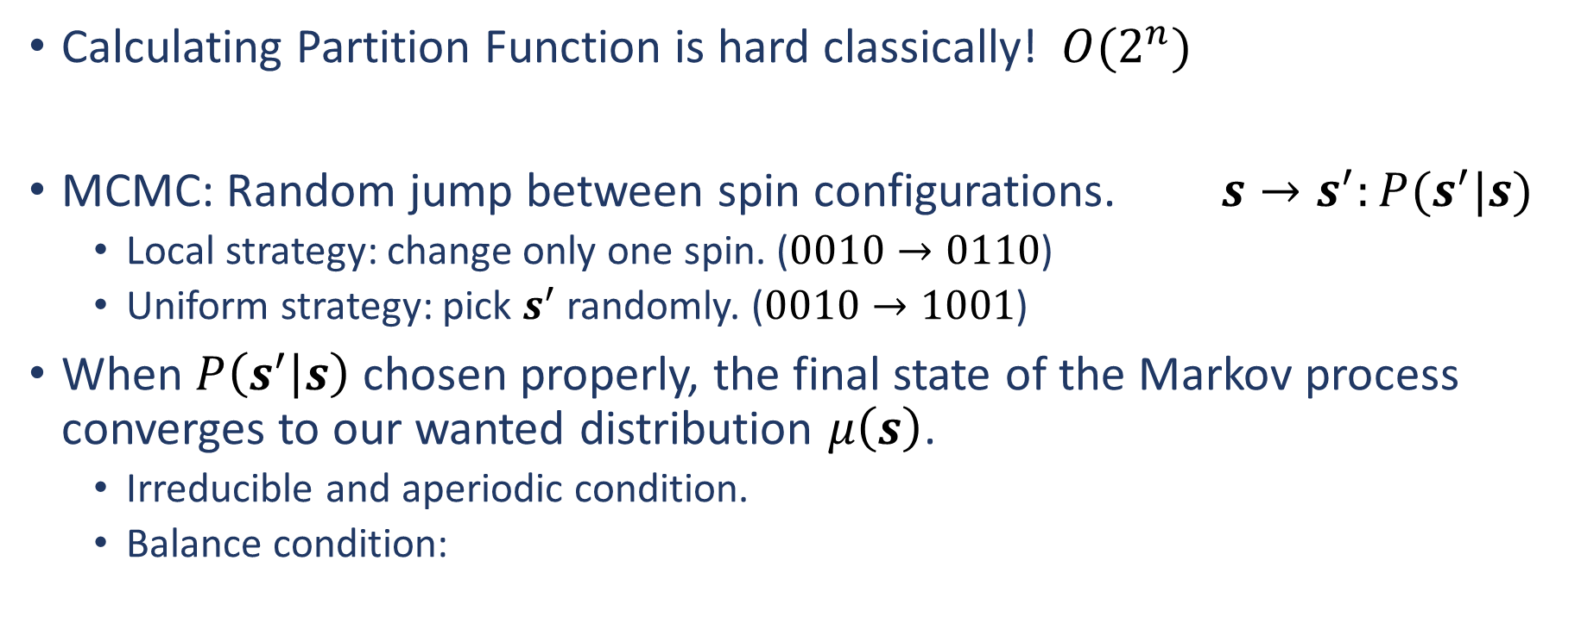
Markov Chain Monte Carlo
Calculating Partition Function is hard classically! $O(2^{n})$
MCMC: Random jump between spin configurations. $s→s^{′}:P(s^{′}|s)$
Local strategy: change only one spin. ($0010→0110$)
Uniform strategy: pick $s^{′}$ randomly. ($0010→1001$)
When $P\left(s^{′} | s\right)$ chosen properly, the final state of the Markov process converges to our wanted distribution $μ\left(s\right)$.
Irreducible and aperiodic condition.
Balance condition:

Slide 4
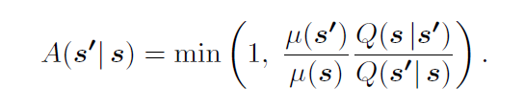
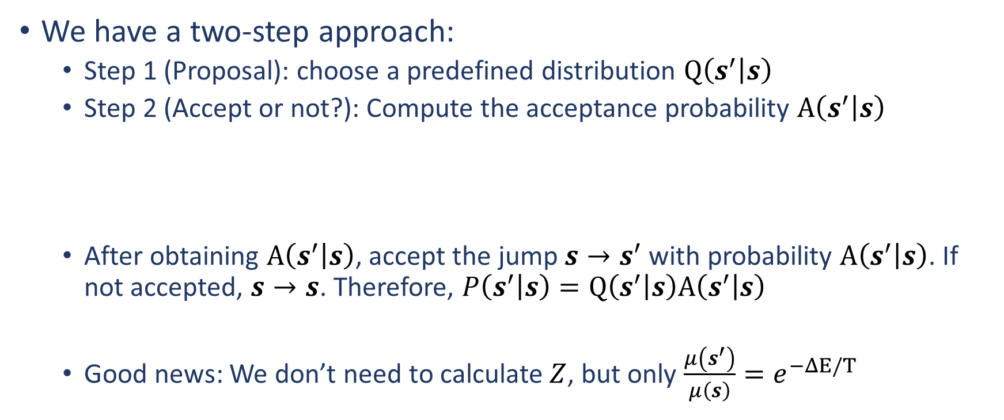

Choosing a good $P\left(s^{′} | s\right)$
We have a two-step approach:
Step 1 (Proposal): choose a predefined distribution $Q\left(s^{′} | s\right)$
Step 2 (Accept or not?): Compute the acceptance probability $A\left(s^{′} | s\right)$
After obtaining $A\left(s^{′} | s\right)$, accept the jump $s→s^{′}$ with probability $A\left(s^{′} | s\right)$. If not accepted, $s→s$. Therefore, $P\left(s^{′} | s\right)=Q\left(s^{′} | s\right)A\left(s^{′} | s\right)$
Good news: We don’t need to calculate $Z$, but only $\frac{μ\left(s^{′}\right)}{μ\left(s\right)}=e^{−ΔE/T}$

Slide 5
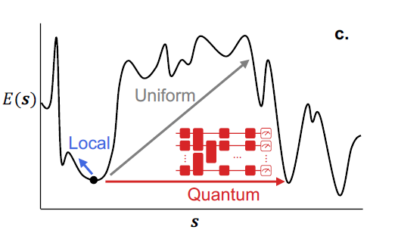

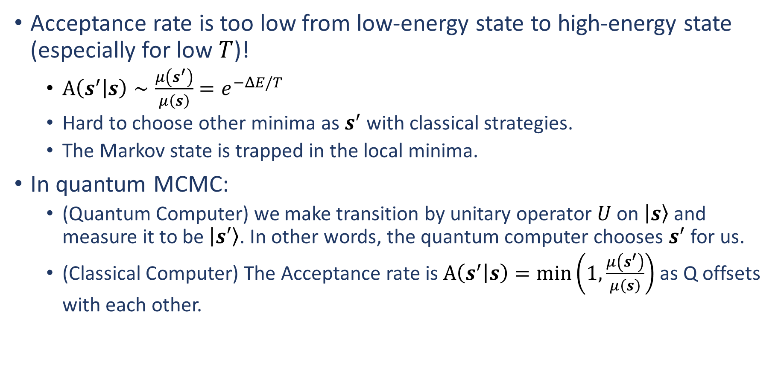
Why go quantum?
Acceptance rate is too low from low-energy state to high-energy state (especially for low $T$)!
$A\left(s^{′} | s\right)∼\frac{μ\left(s^{′}\right)}{μ\left(s\right)}=e^{−ΔE/T}$
Hard to choose other minima as $s^{′}$ with classical strategies.
The Markov state is trapped in the local minima.
In quantum MCMC:
(Quantum Computer) we make transition by unitary operator $U$ on $\left|s\right\rangle$ and measure it to be $\left|s′\right\rangle$. In other words, the quantum computer chooses $s^{′}$ for us.
(Classical Computer) The Acceptance rate is $A\left(s^{′} | s\right)=\min\left(1,\frac{μ\left(s^{′}\right)}{μ\left(s\right)}\right)$ as Q offsets with each other.

Slide 6
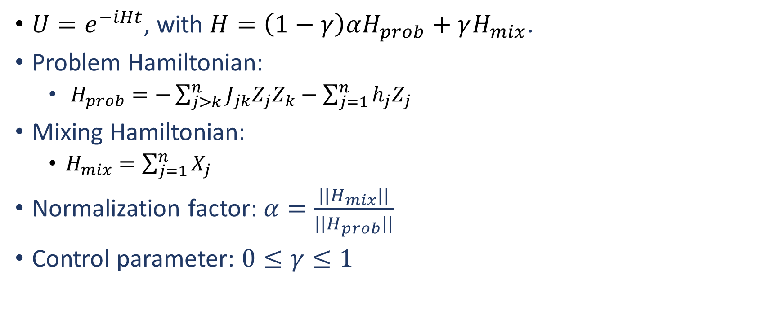

Choosing a good $U$
$U=e^{−iHt}$, with $H=\left(1−γ\right)αH_{prob}+γH_{mix}$.
Problem Hamiltonian:
$H_{prob}=−\sum_{j>k}^{n}{J_{jk}Z_{j}Z_{k}−\sum_{j=1}^{n}{h_{j}Z_{j}}}$
Mixing Hamiltonian:
$H_{mix}=\sum_{j=1}^{n}{X_{j}}$
Normalization factor: $α=\frac{||H_{mix}||}{||H_{prob}||}$
Control parameter: $0≤γ≤1$

Slide 7
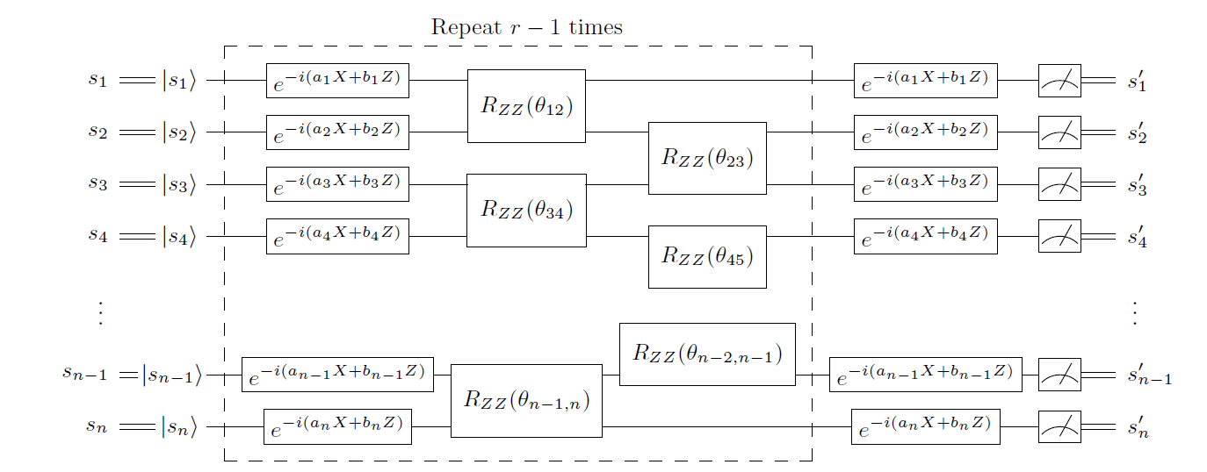
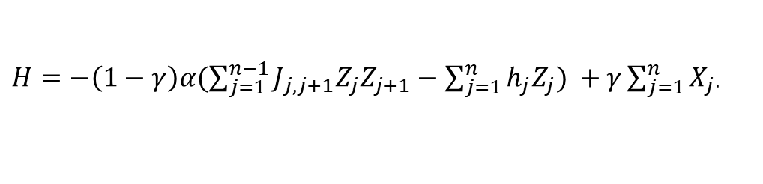
Trotterization circuit
H1
H2
$H=−\left(1−γ\right)α(\sum_{j=1}^{n−1}{J_{j,j+1}Z_{j}Z_{j+1}−\sum_{j=1}^{n}{h_{j}Z_{j}}) }+γ\sum_{j=1}^{n}{X_{j}}$.

Slide 8
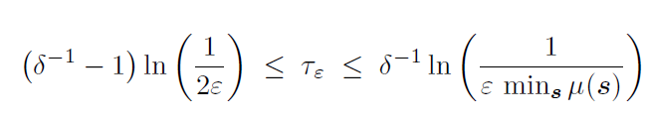
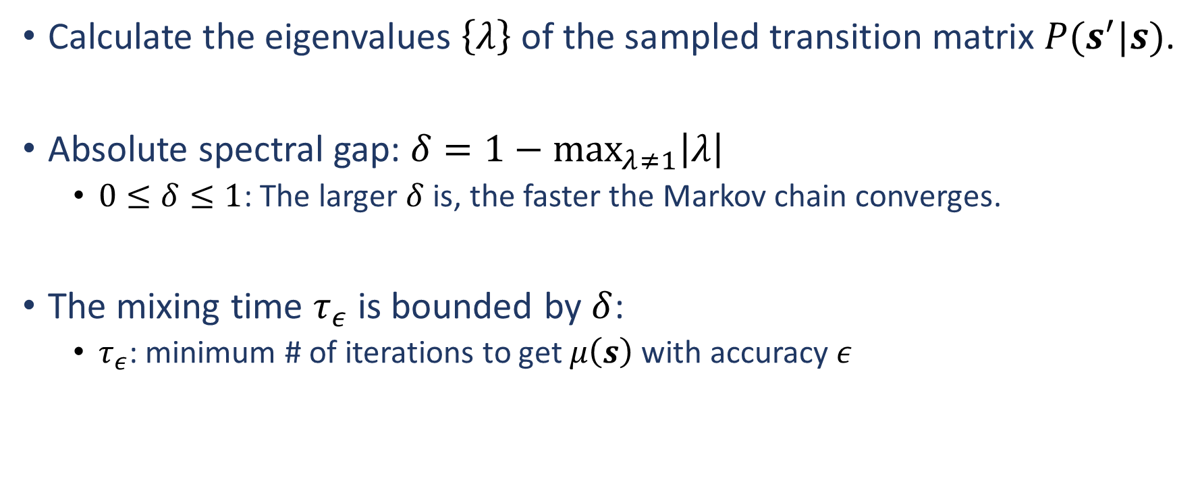

Performance metric - $δ$
Calculate the eigenvalues $\left\{λ\right\}$of the sampled transition matrix $P(s^{′}|s)$.
Absolute spectral gap: $δ=1−\max_{λ≠1}\left|λ\right|$
$0≤δ≤1$: The larger $δ$ is, the faster the Markov chain converges.
The mixing time $τ_{ε}$ is bounded by $δ$:
$τ_{ε}$: minimum # of iterations to get $μ\left(s\right)$ with accuracy $ε$

Slide 9
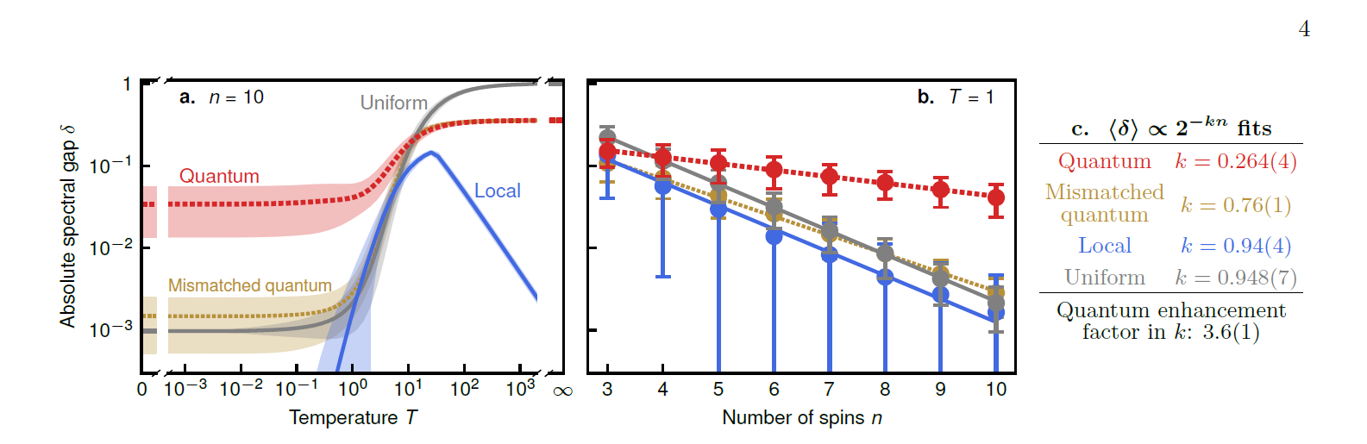

Result - Simulation
500 random fully-connected Ising model instances $n$.
In low temperature, the quantum algorithm greatly outperforms the classical algorithm(uniform & local).
The scaling with $n$ is 3.6 times better than the classical algorithm ($T=1$).

Slide 10
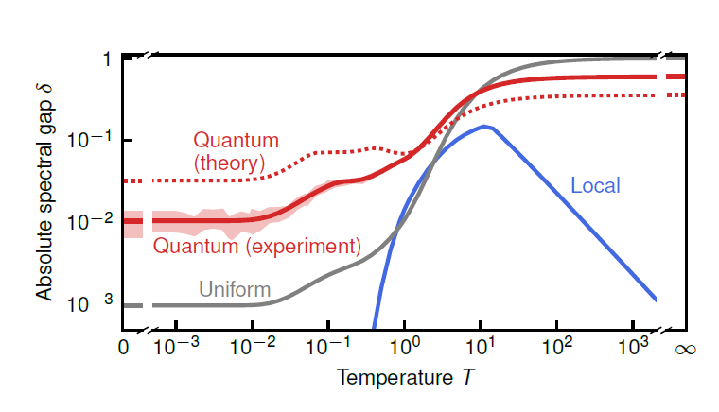
Result – Experiment on a real quantum device
Experimental result falls behind theory predication (due to noise), but still outperforms classical algorithm.

Slide 11
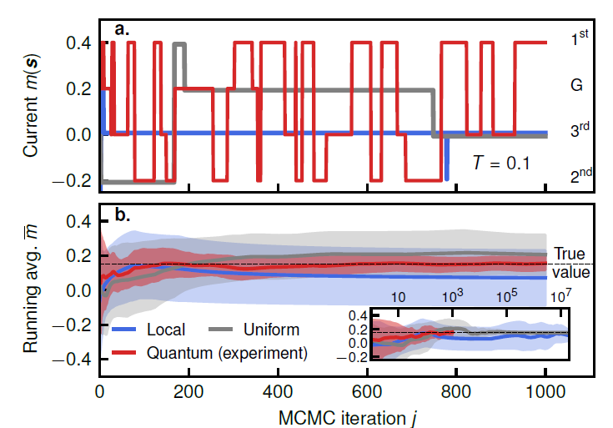
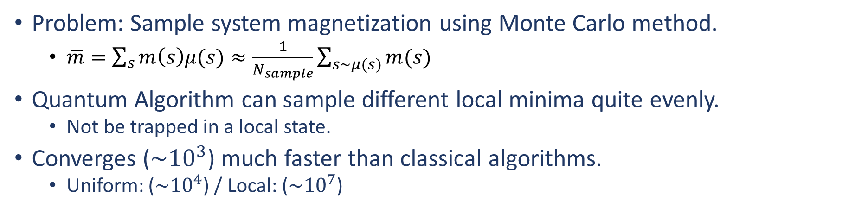
Application – magnetization estimation
Problem: Sample system magnetization using Monte Carlo method.
$\overline{m}=\sum_{s}{m\left(s\right)μ(s)}≈\frac{1}{N_{sample}}\sum_{s\sim μ(s)}{m(s)}$
Quantum Algorithm can sample different local minima quite evenly.
Not be trapped in a local state.
Converges ($\sim {10}^{3}$) much faster than classical algorithms.
Uniform: ($\sim {10}^{4}$) / Local: ($\sim {10}^{7}$)

Slide 12
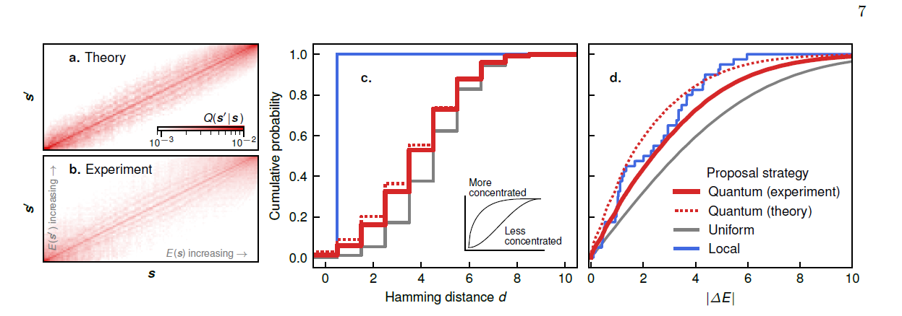
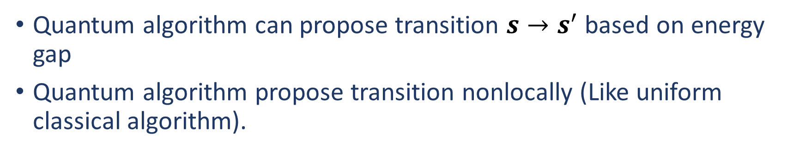
Quantum Speed-up
Quantum algorithm can propose transition $s→s^{′}$based on energy gap
Quantum algorithm propose transition nonlocally (Like uniform classical algorithm).

Slide 13
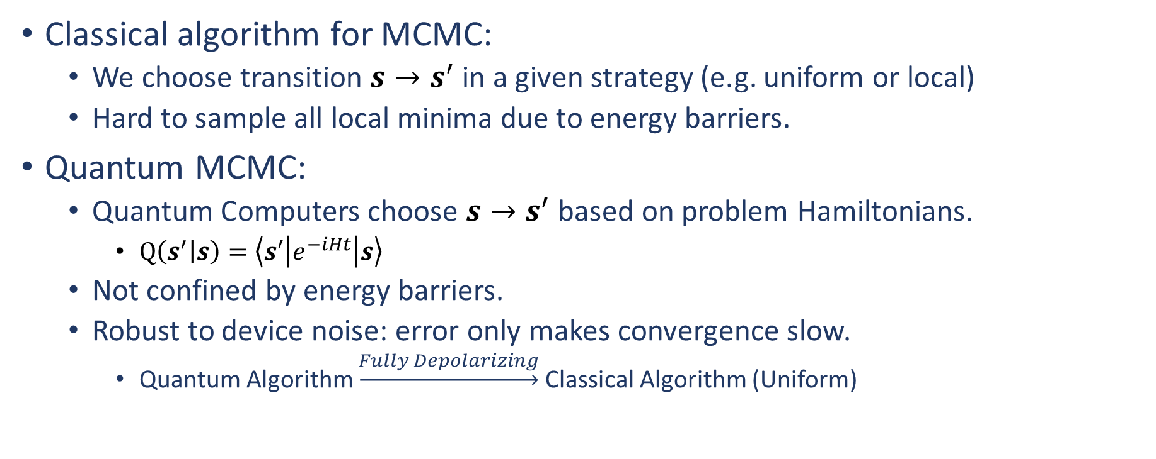
Summary
Classical algorithm for MCMC:
We choose transition $s→s^{′}$ in a given strategy (e.g. uniform or local)
Hard to sample all local minima due to energy barriers.
Quantum MCMC:
Quantum Computers choose $s→s^{′}$ based on problem Hamiltonians.
$Q\left(s^{′} | s\right)=\left\langle s′\left|e^{−iHt}\right|s\right\rangle$
Not confined by energy barriers.
Robust to device noise: error only makes convergence slow.
Quantum Algorithm $\underset{→}{Fully Depolarizing}$ Classical Algorithm (Uniform)

Slide 14
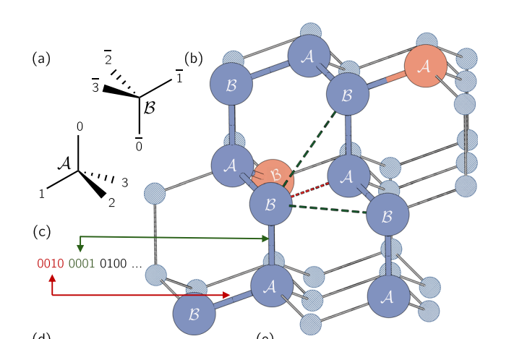
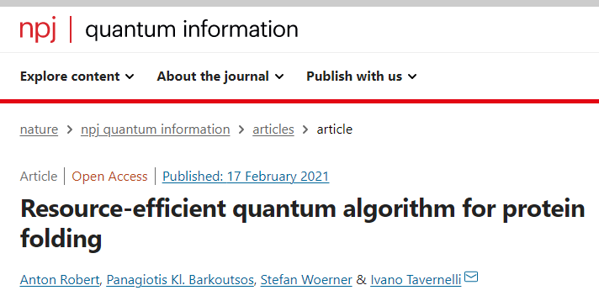
Future research direction
Associate this method with Protein Folding:
Protein Folding with Quantum Computer is of great commercial value in the near-term future. But it is greatly overlooked by the academia.
Specifically: Try to find out a quantity that governs the protein structure using this sampling method.

Slide 15

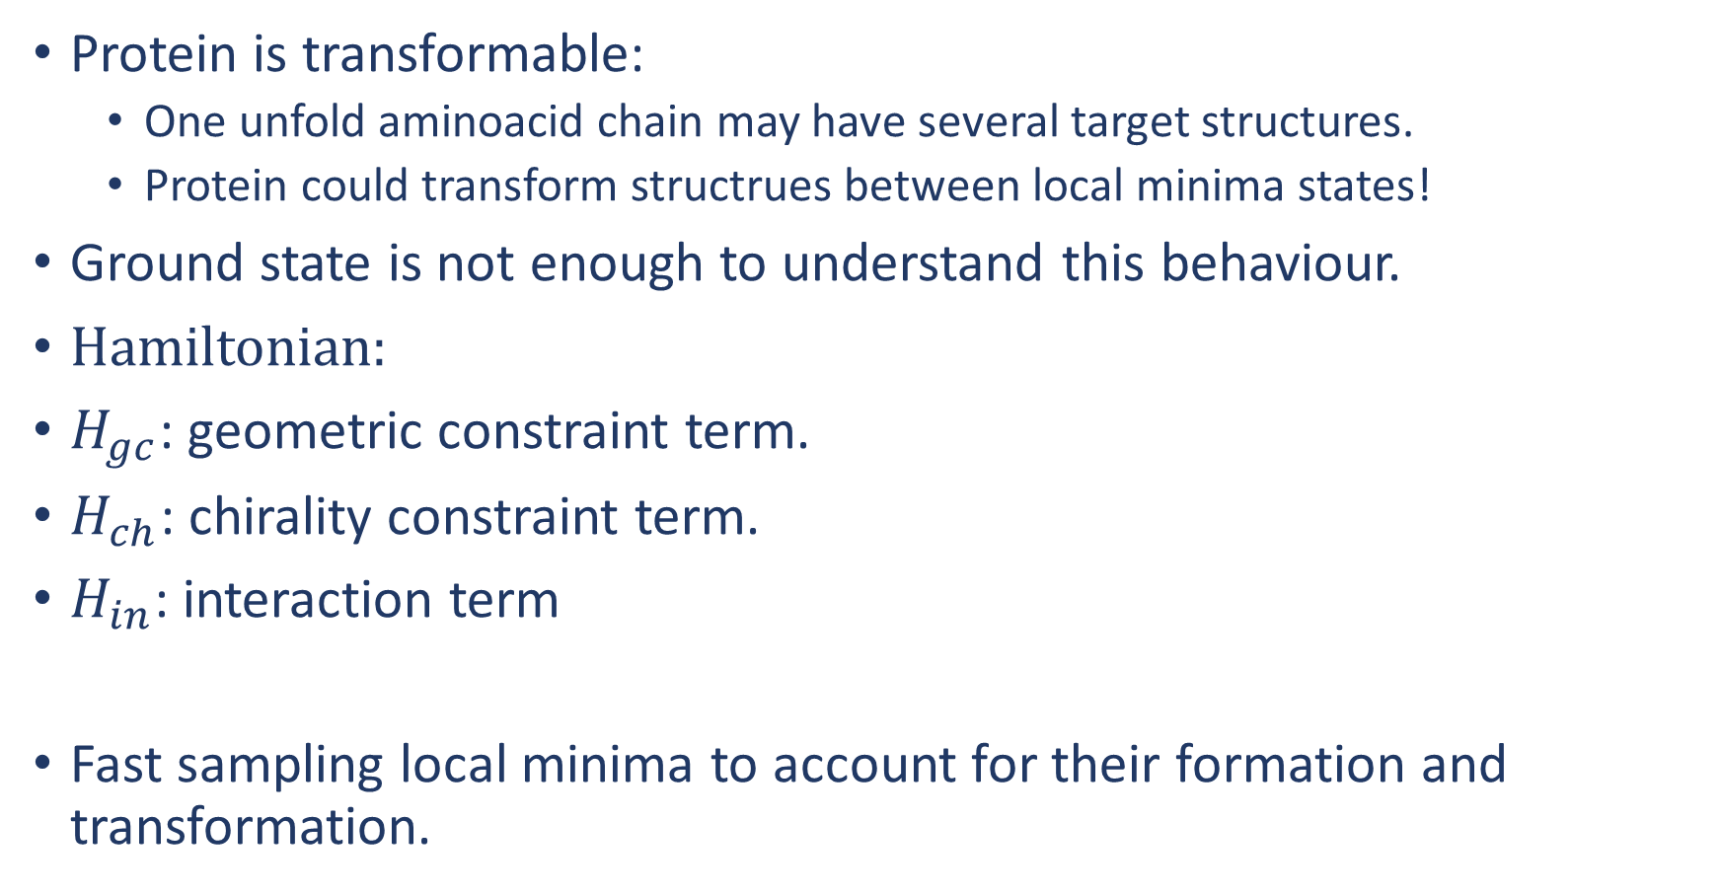
Protein Folding
Protein is transformable:
One unfold aminoacid chain may have several target structures.
Protein could transform structrues between local minima states!
Ground state is not enough to understand this behaviour.
Hamiltonian:
$H_{gc}$: geometric constraint term.
$H_{ch}$: chirality constraint term.
$H_{in}$: interaction term
Fast sampling local minima to account for their formation and transformation.

Slide 16
Research goal (2-3 month internship)
Clearly define the problem model to sample protein structure.
Develop an efficient sampling method for the protein Hamiltonian.
Demonstrate the quantum advantage with a small example (e.g. peptide).

